Slide 1

Safely Navigating the Bermuda Triangle
Reply barcamp 2016, Oct. 7th 2016

Slide 2
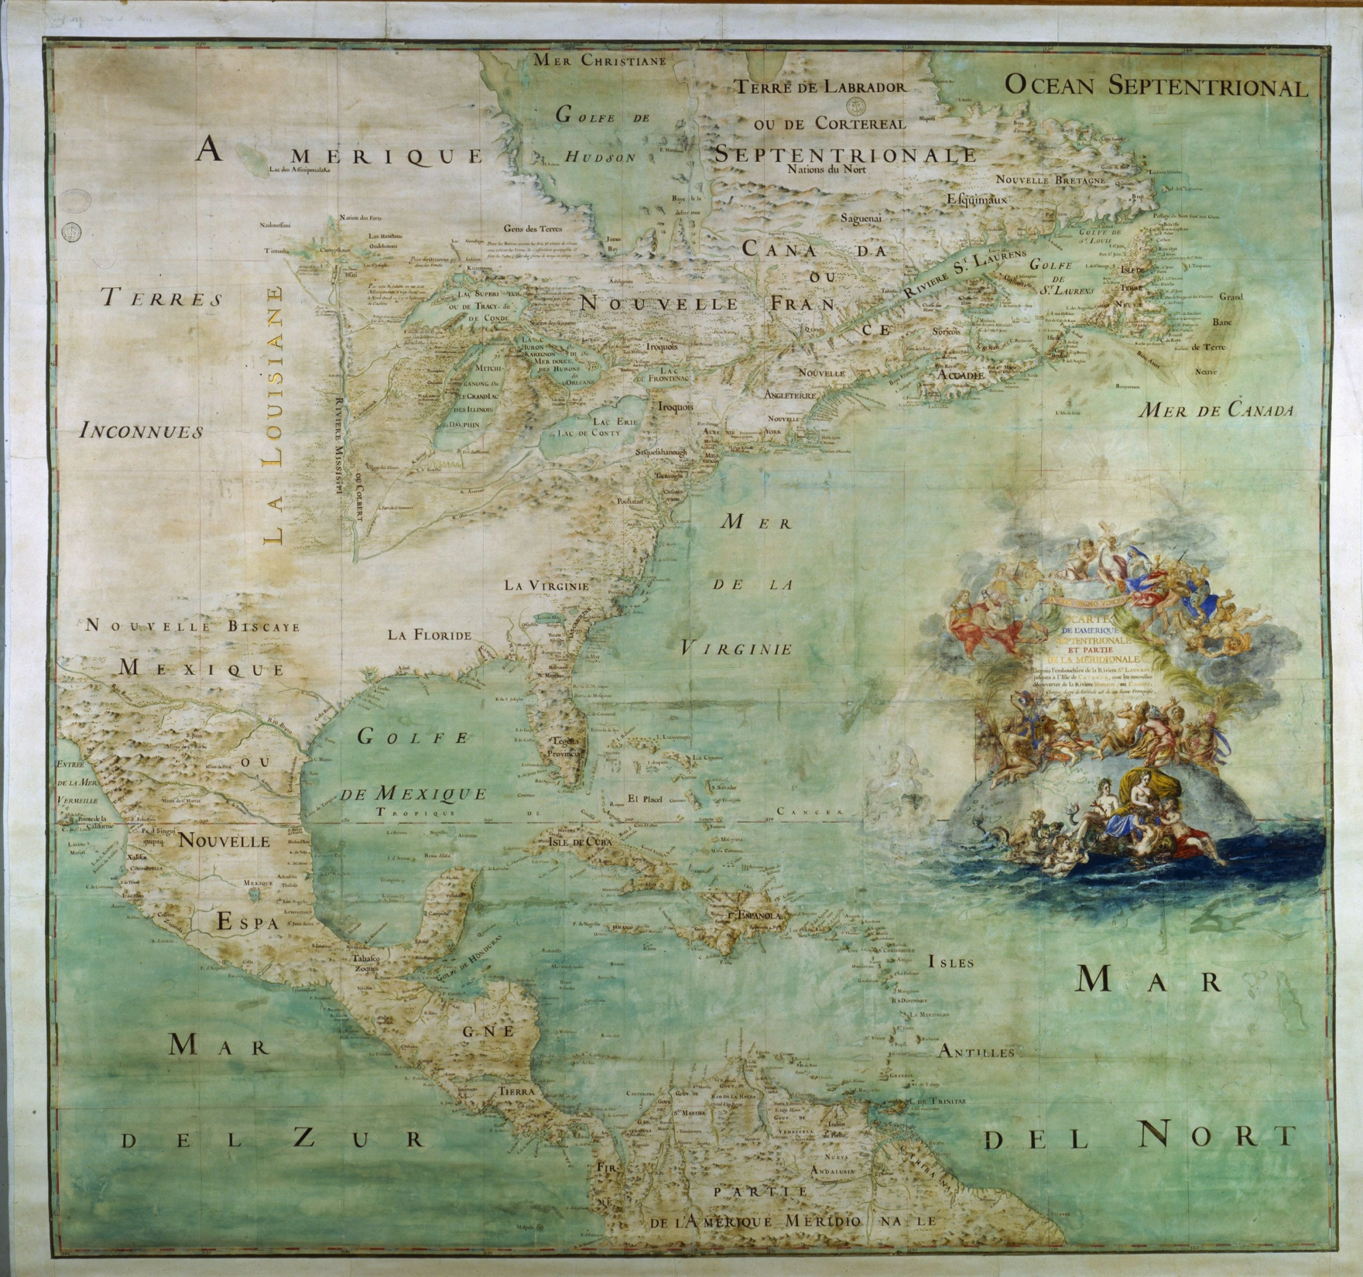


We
love
Geco!

Slide 3
The history
Problems
Proto-solution
The Bermuda Triangle

Slide 4
The history
2013: Triplesense becomes Triplesense-Reply
2013 - 2014: Systems integration
2014: Initial introduction to Geco
2014 - 01.2016: Piracy, storms, damnation on the high seas
Notes:
Touch on the agile transformation
Fewer tools

Slide 5
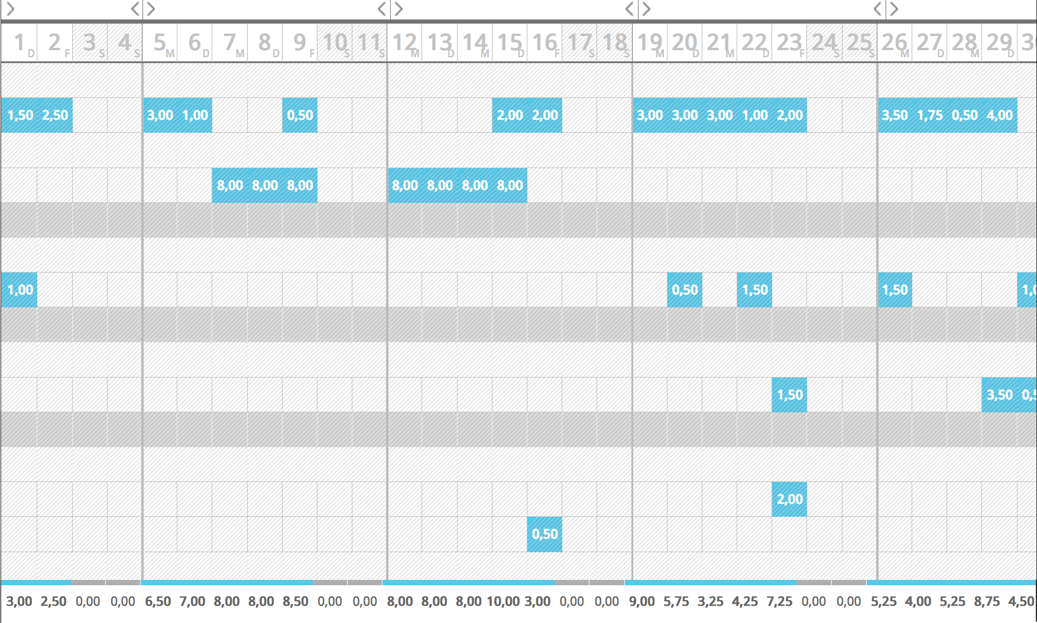
Notes:
Not only many daily entries, but also multiple tasks per entry
If one entry in a block is improper, the entire block is rejected and the PM has to send a detailed comment about what has to be fixed
Transparency
Clients often want itemised billing. Retainers and T&M projects are a rarity, as are jobs which require fewer, identical bookings
We do as much production as consulting
What happens when an entry gets lost or misplaced?

Slide 6
2. Problems
Differences in project culture
Superfluous data-entry
No connectivity between work, time-reporting and billing
Rum consumption increased
Timelogs: lost at sea
Notes:
Getting the time reports filled out properly was nearly impossible
One project vs. 10
Client, projects, tasks
Often, each task is a JSO

Slide 7

Giant Kraken!
Notes:
Polpo gigante
Wild Excuses... ;-)

Slide 8

Giant Kraken!
Green fog, aliens, etc...
Notes:
Extraterrestriali nebbia verde

Slide 9
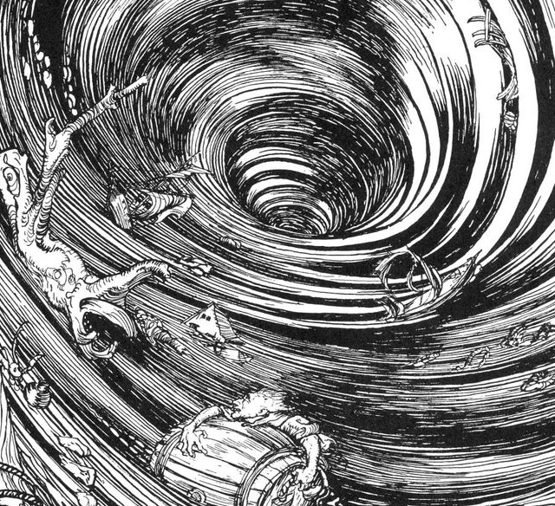
Giant Kraken!
Maelström!
Green fog, aliens, etc...
Notes:
Tempesta malevolente

Slide 10
3. Proto-solution
Scripting to improve the usability and data-entry with Geco
Better adapted to our projects
Improved exportability to controlling tools

Slide 11
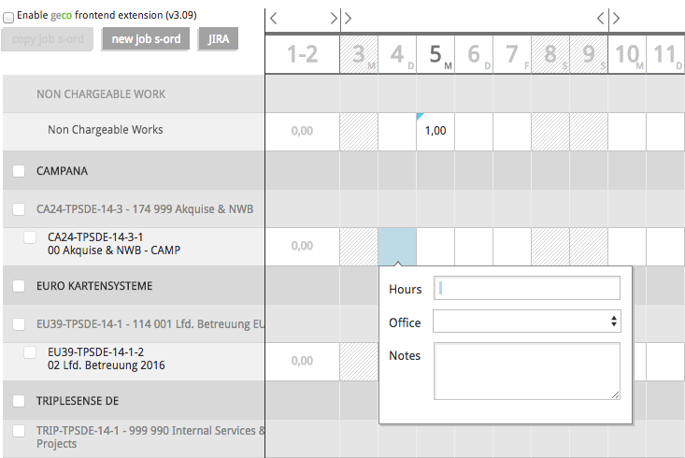
Proto-solution
Notes:
Illustrating that the structure of GECO was completely inappropriate to our project culture

Slide 12
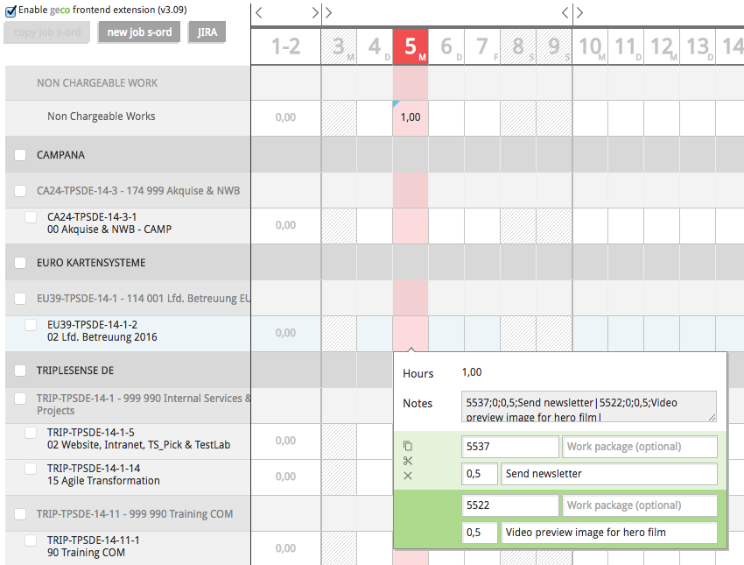
Proto-solution
Notes:
Scripting provides
*Highlighting
*Multiple entries into one daily block
*Concatenating the results for parsing in Xcel, SAP, etc
*Office entry is a default, because all our work is reported in-office

Slide 13
4. The Bermuda Triangle
Notes:
The three dangers to time entries
Time = money, Loss = money lost

Slide 14
4. The Bermuda Triangle
SAP-Data
Notes:
Jobnumbers: only the PMs have them memorised. Mistype = rejection or lost entry
999 990 09 00
Mysterous, Ten-digit number

Slide 15
4. The Bermuda Triangle
SAP-Data
Jira
Notes:
JIRA: Filtration / Searchability, Time-Tracking and GECO require JSO‘s and Project names

Slide 16
4. The Bermuda Triangle
SAP-Data
Geco
Jira
Notes:
Dangerous waters for sailing

Slide 17
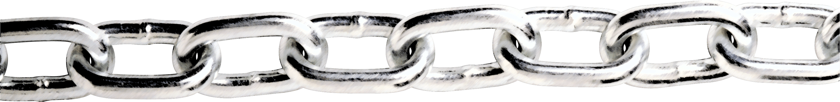
4. The Bermuda Triangle
SAP-Data
Geco
Jira

Slide 18
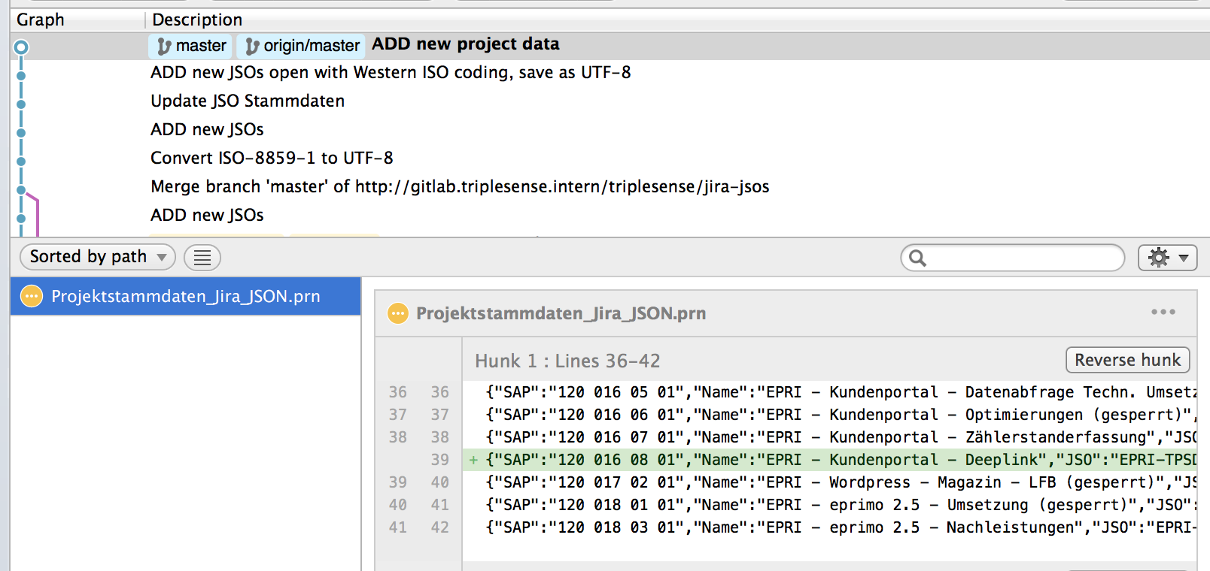
4. The Bermuda Triangle
Notes:
Which job will that be booked to?
415 jobs and they keep changing
Automatically get SAP project data into Jira, rather than manually configure the entry fields
Thin solution required -> no db, server scripting, or SAP interconnectivity

Slide 19
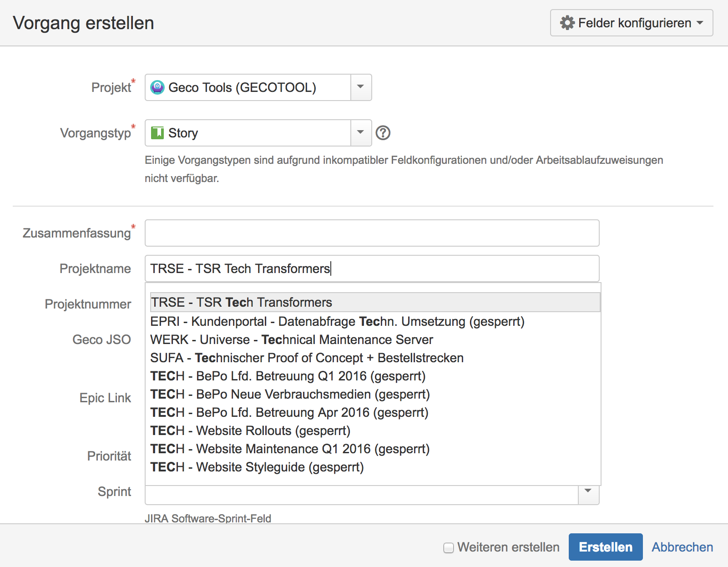
4. The Bermuda Triangle
Notes:
Which job will that be booked to?
415 jobs and they keep changing
SAP number, JSO, Project name

Slide 20
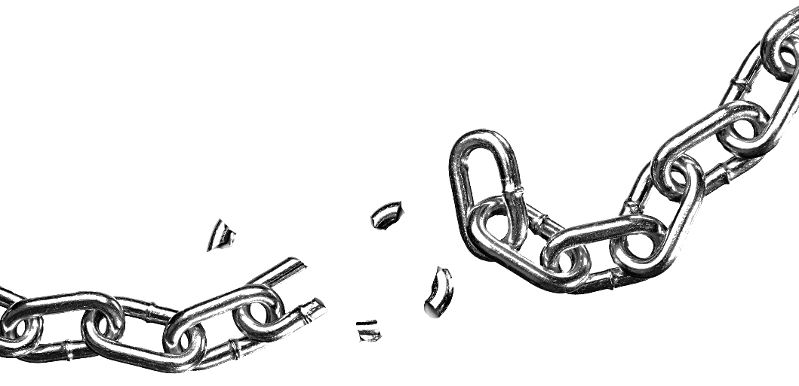
4. The Bermuda Triangle
SAP-Data
Geco
Jira

Slide 21
4. The Bermuda Triangle
SAP-Data
Geco
Jira

Slide 22
4. The Bermuda Triangle
SAP-Data
Geco
Jira

Slide 23
On the horizon...
Updating our solutions
Conceptual issues with post-dating
Better connectivity & more automation

Slide 24
Thank you! Captain Dan Triplesense Reply

